Slide 1

Deep learning Project Presentation
- Mukul, Hunter and Priyesh

Slide 2

Problem Statement and Dataset used
Problem statement: Develop a Named Entity Recognition (NER) model to identify and categorize chemical entities in scientific text, including trivial names, systematic names, abbreviations, chemical formulas, family names, and registry identifiers, by assigning appropriate IOB tags to the tokens in the text. By creating an NER model that can accurately recognize and classify chemical entities in scientific documents, you can facilitate information extraction, data analysis, and a range of other applications in chemistry and related fields.
Datasets: https://www.kaggle.com/datasets/abhinavwalia95/chemdner-iob-annotated-chemical-named-etities

Slide 3
Significance of Project
Working on ChemdNER data enables the extraction of valuable information related to chemicals, drugs, and their biological interactions from the vast and ever-growing body of scientific literature.
By effectively identifying chemical entities and their relations through the NER task, researchers, healthcare professionals, and pharmaceutical companies can more efficiently discover new drug candidates, understand side effects, drug-drug interactions, and potential therapeutic applications.
This can lead to better-informed decisions in drug development, more targeted treatments, and personalized medicine, ultimately contributing to improved patient outcomes and potentially saving lives.
The NER model we've fine-tuned for recognizing chemical entities specifically helps by automating the extraction of relevant chemical information, streamlining the research process, and accelerating the discovery of new insights in the field of chemistry and medicine.

Slide 4
Overview of Methods
This project utilizes the Hugging Face Transformers library to fine-tune a pre-trained model for Named Entity Recognition (NER) on a custom dataset containing chemical entities.
The model and tokenizer are saved after training and then used to create a NER pipeline. The pipeline is applied to a given example text and the results are displayed.
Additionally, a randomly selected sentence from the validation dataset is processed and its entities are visualized using the Spacy library, with custom colors for each entity tag. The main goal of the project is to use a fine-tuned NER model for recognizing chemical entities in CHEMDNER corpus of chemicals and drugs.

Slide 5

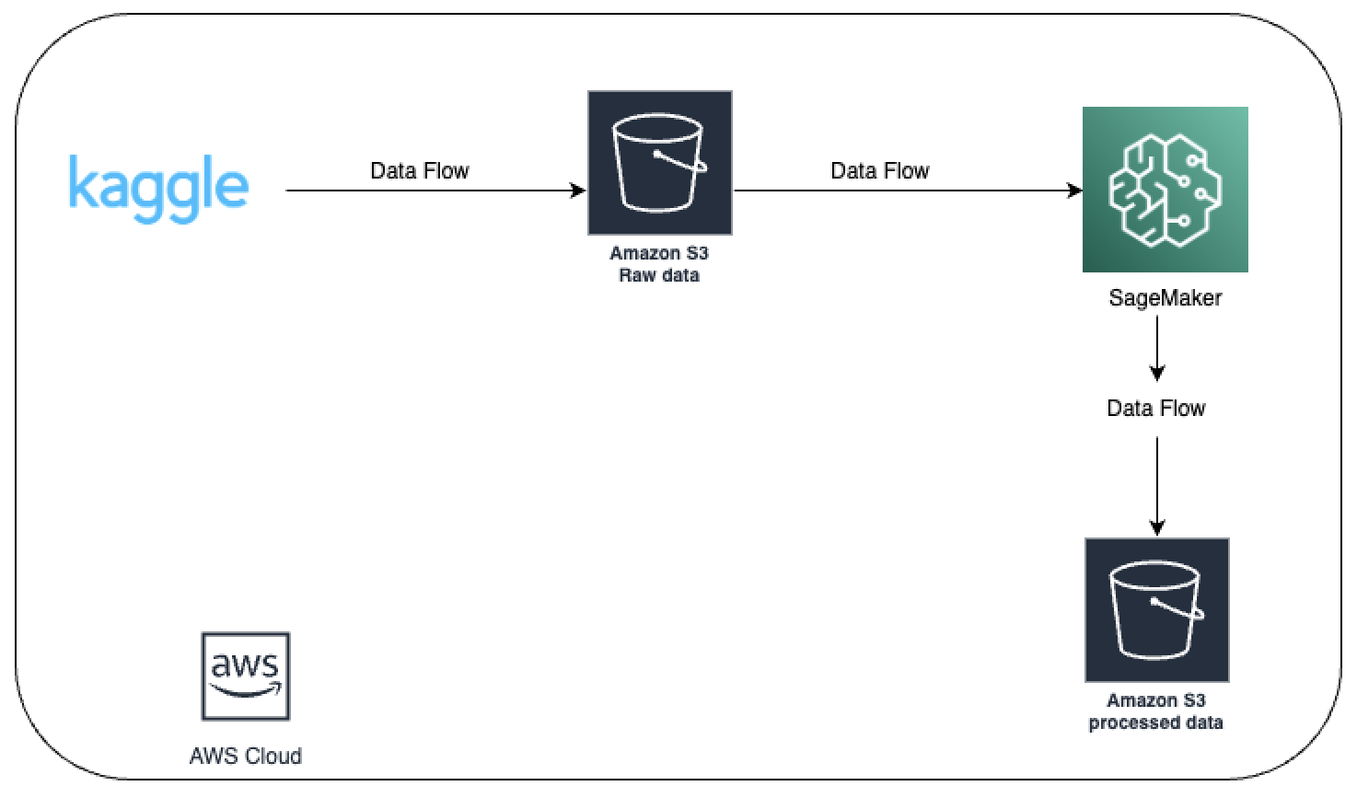
Architecture

Slide 6

Step 1 : Preprocessing the Data
Training data
Validation data
Evaluation data

Slide 7
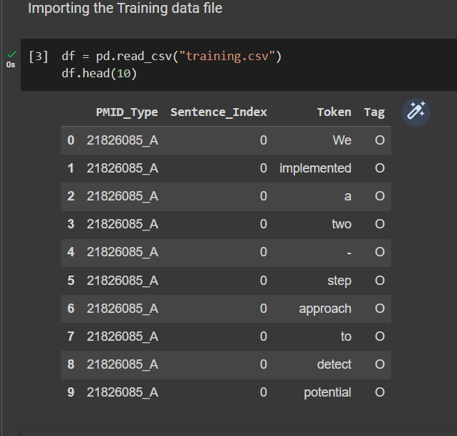
Thank You

Slide 8
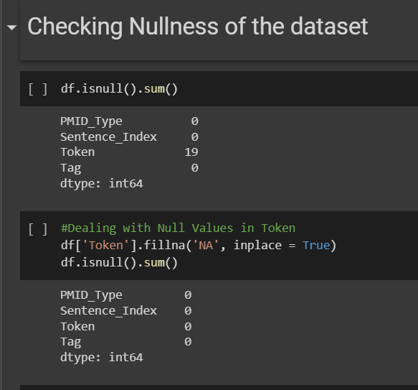

Slide 9
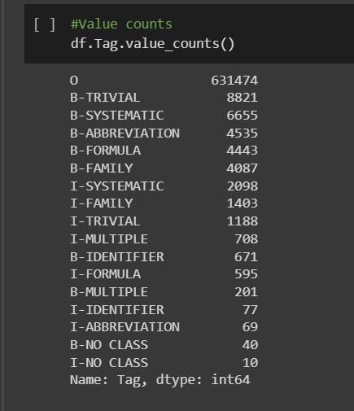
After observing the value counts of Tags, we decided to drop Tags [B-MULTIPLE,I-IDENTIFIER, I-ABBREVIATION, B-NO CLASS, I-NO CLASS] because of low
count (Imbalanced)

Slide 10
An explanation of each tag:
O: Outside - This tag represents a token that is not part of any chemical named entity.
B-TRIVIAL: Beginning of a trivial (common) name of a chemical entity. Trivial names are non-systematic names that are widely accepted and used in the scientific community, e.g., "aspirin."
B-SYSTEMATIC: Beginning of a systematic (IUPAC) name of a chemical entity. Systematic names follow a set of rules defined by the International Union of Pure and Applied Chemistry (IUPAC), e.g., "2-(acetyloxy)benzoic acid."
B-ABBREVIATION: Beginning of an abbreviation or acronym representing a chemical entity, e.g., "DMSO" for dimethyl sulfoxide.
B-FORMULA: Beginning of a chemical formula, e.g., "H2O" for water.
B-FAMILY: Beginning of a chemical family name, which refers to a group of related chemical compounds, e.g., "steroids" or "alkanes."
I-SYSTEMATIC: Inside a multi-token systematic (IUPAC) name of a chemical entity.
I-FAMILY: Inside a multi-token chemical family name.
I-TRIVIAL: Inside a multi-token trivial (common) name of a chemical entity.
I-MULTIPLE: Inside a multi-token chemical entity representing a mixture or multiple chemicals, e.g., "Fe2O3/SiO2."
B-IDENTIFIER: Beginning of a registry identifier, such as a Chemical Abstracts Service (CAS) number or other unique identifiers for chemical entities.
I-FORMULA: Inside a multi-token chemical formula.
These tags allow you to identify and categorize various chemical entities in scientific texts, such as chemical names, abbreviations, formulas, and families, which is crucial for extracting and analyzing chemical information from the literature.

Slide 11
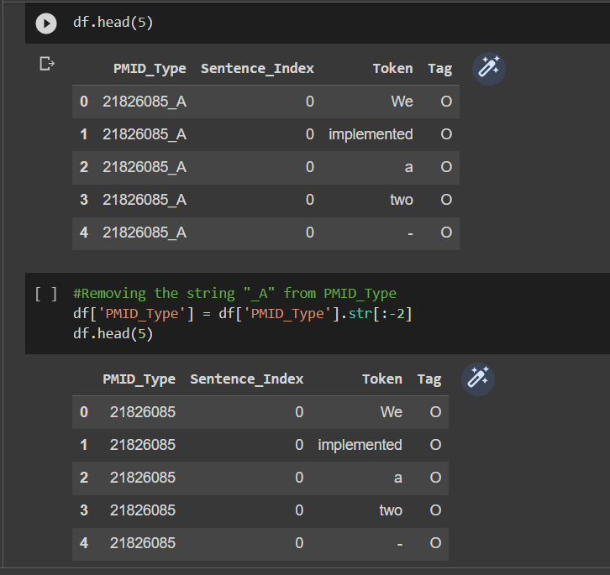

Slide 12
In the next slide we are grouping the DataFrame df by the 'PMID_Type' column and then aggregating the values in the other columns for each group

Slide 13
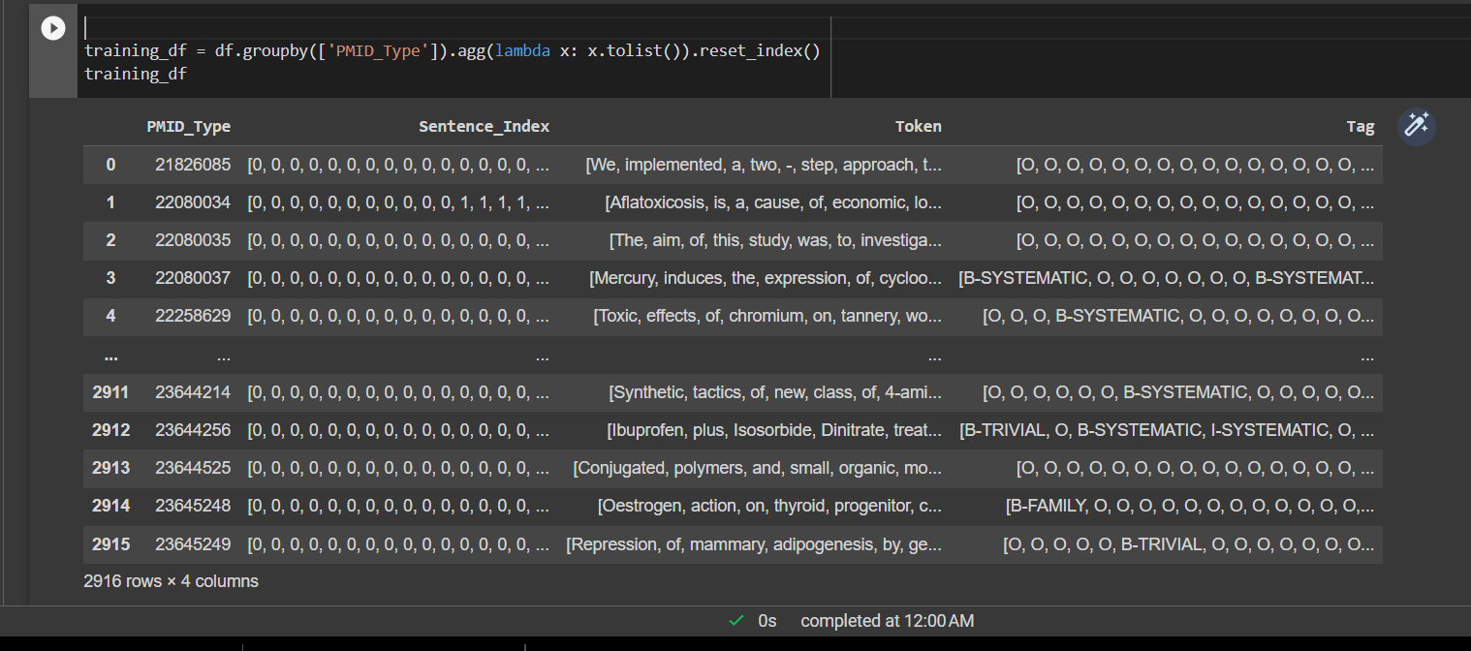

Slide 14

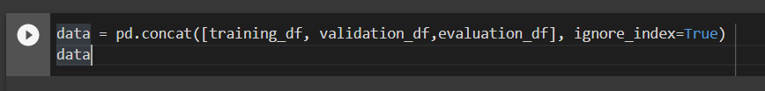
1. Now, we do the Step 1 for Validation and evaluation set as well. 2. We now have 3 dataframe ready which are training_df, validation_df, evaluation_df. 3. Then, we combine all these dataset into single big dataset to avoid unnecessary complexity in the future.

Slide 15
Step 2 : Transforming the Data for further process

Slide 16
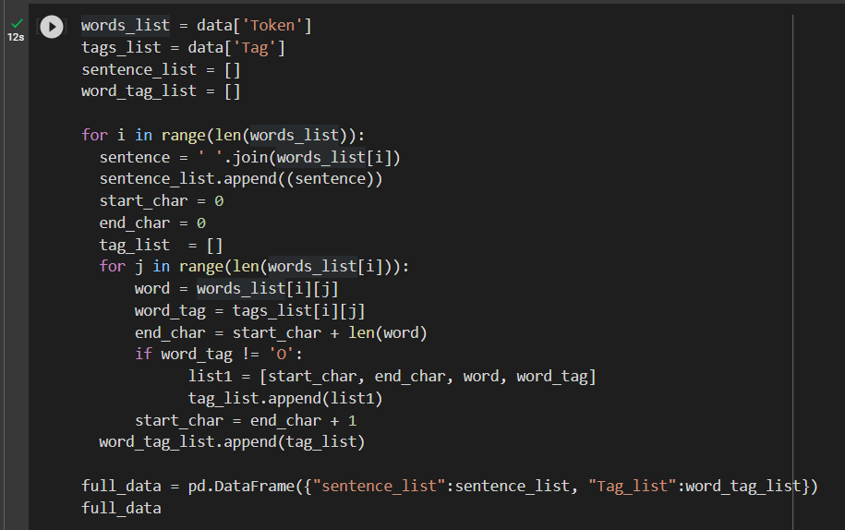
Lets create a dataframe where Each row in the DataFrame will correspond to a sentence in the original dataset, and the tags will indicate the start and end positions of named entities and their type. For example, in the second row, the word 'aflatoxin' will be tagged as a member of the 'B-FAMILY' entity type at character positions 197-206, 613-622, 741-750, 1107-1116, 1342-1351, and 1420-1429.

Slide 17
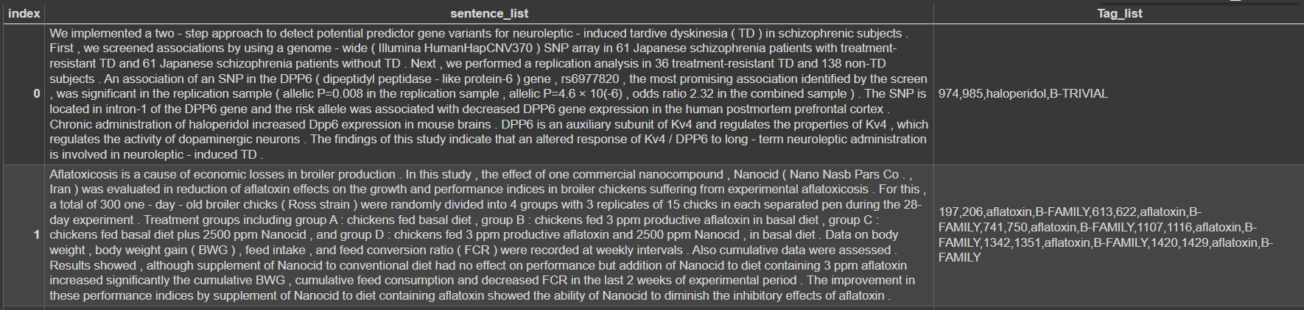

Slide 18
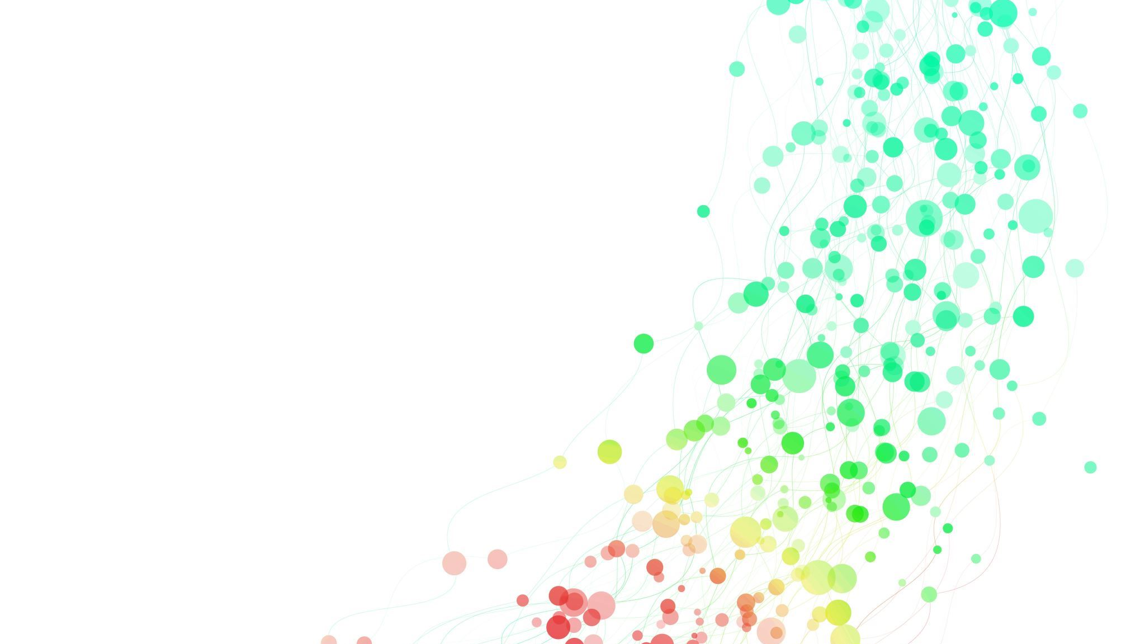
Now, Let's create a list valid_data_list that stores the data in a format suitable for training an NER model. It will contain start, end, Tags, Entity.
valid_data_list[5]
{'text': 'Preliminary investigation of a number of plant extracts for allelopathic activity using seed germination inhibition bioassay showed a promising activity of the water extract of the aerial parts of Mikania scandens . Activity - guided fractionation of the M . scandens extract led to the isolation of the highly allelopathic active compound mikanolide , with minimum inhibitory concentration of 0.083 µM mL(-1) . As M . scandens is a highly abundant invasive plant in Sri Lanka and other South Asian countries , this plant could be developed as an environment friendly natural herbicide , either in crude form as shredded plant material or as pure mikanolide , which is the major constituent ( ∼0.02% ) in the plant .', 'entities': [[340, 350, 'mikanolide', 'B-TRIVIAL'], [647, 657, 'mikanolide', 'B-TRIVIAL']]}

Slide 19

Step 3: Now that Data looks good enough, We start with Modeling Part

Slide 20
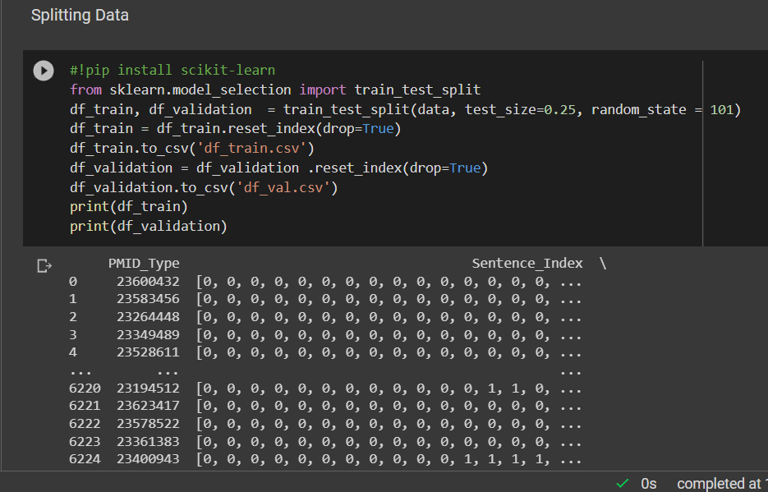

Slide 21
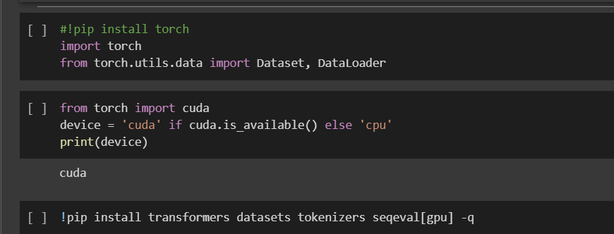
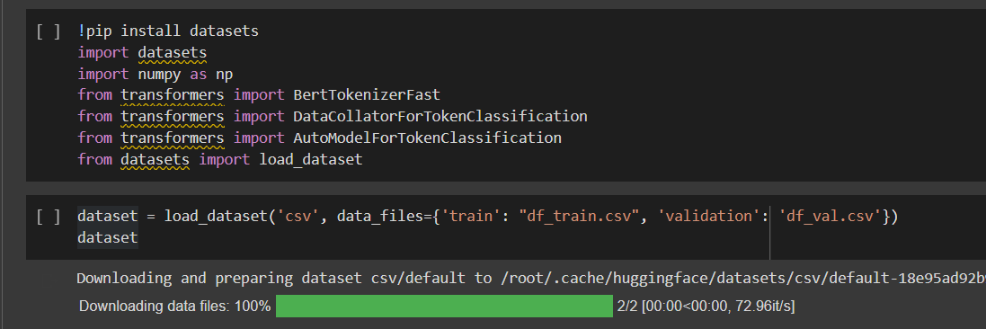

Slide 22
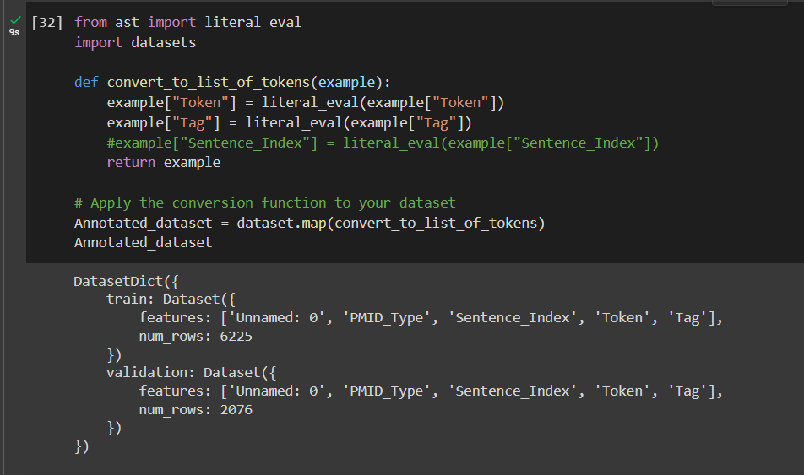
# Define a function to convert a string of tokenized sentences to a list of tokens

Slide 23
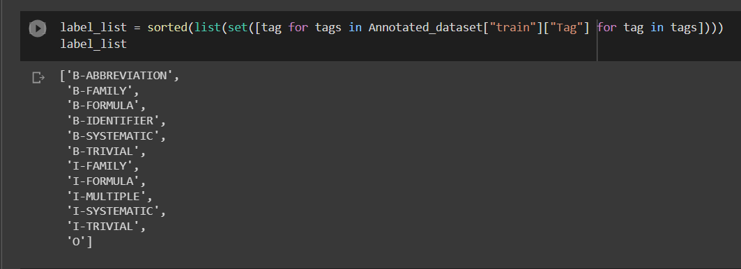
Creating a List of Lables to convert them later into ids

Slide 24
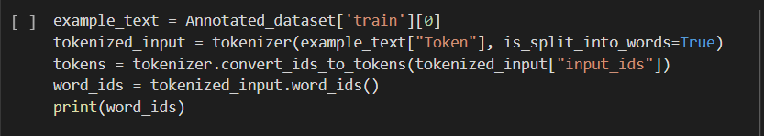
Now , we will have to align input_ids with their respective labels. The function returns a list with the same number of elements as our processed input ids,
mapping special tokens to None and all other tokens to their respective word
[None, 0, 1, 2, 2, 2, 2, 2, 2, 3, 4, 4, 4, 5, 6, 7, 8, 9, 10, 11, 12, 12, 12, 12, 13, 14, 15, 16, 17, 18, 19, 19, 19, 20, 21, 22, 23, 23, 24, 24, 24, 24, 24, 25, 26, 26, 27, 28, 29, 30, 31, 32, 33, 34, 35, 35, 35, 35, 35, 35, 36, 37, 38, 38, 39, 40, 41, 41, 42, 43, 44, 44, 44, 44, 44, 45, 46, 47, 48, 49, 50, 51, 52, 53, 53, 53, 54, 55, 56, 57, 58, 59, 60, 61, 62, 63, 64, 65, 66, 67, 68, 69, 70, 71, 72, 72, 72, 73, 74, 75, 75, 75, 76, 77, 78, 79, 80, 81, 82, 83, 84, 85, 86, 87, 88, 89, 90, 91, 92, 93, 93, 93, 93, 93, 94, 95, 96, 96, 96, 97, 98, 99, 100, 101, 102, 102, 102, 103, 104, 105, 106, 107, 108, 109, 110, 111, 112, 113, 114, 114, 114, 115, 116, 116, 117, 118, 119, 120, 121, 122, 123, 124, 125, 126, 127, 127, 127, 127, 127, 127, 127, 127, 127, 128, 129, 129, 129, 129, 130, 131, 131, 132, 133, 134, 135, 136, 137, 138, 139, 140, 141, 142, 143, 144, 145, 146, 147, 148, 149, 150, 151, 152, 153, 154, 155, 155, 155, 156, 157, 158, 159, 160, 161, 162, 163, 164, 165, 166, 167, 168, 169, 170, 171, 172, 173, 174, 175, 176, 177, 178, 179, 180, 181, 182, 183, 184, 185, 186, 187, 188, 189, 190, 191, 191, 191, 192, 193, 194, 195, 196, 197, 198, 199, 200, 201, 202, 203, 204, 205, 206, 207, 208, 209, 210, 211, 212, 213, 214, 215, 216, 217, 218, 219, 220, 221, 222, 223, 224, 225, 226, 227, 228, 228, 228, 229, 230, 230, 230, 230, 230, 231, 232, None]
' As we can see, it returns a list with the same number of elements as our processed input ids, \nmapping special tokens to None and all other tokens to their respective word. \nThis way, we can align the labels with the processed input ids.

Slide 25
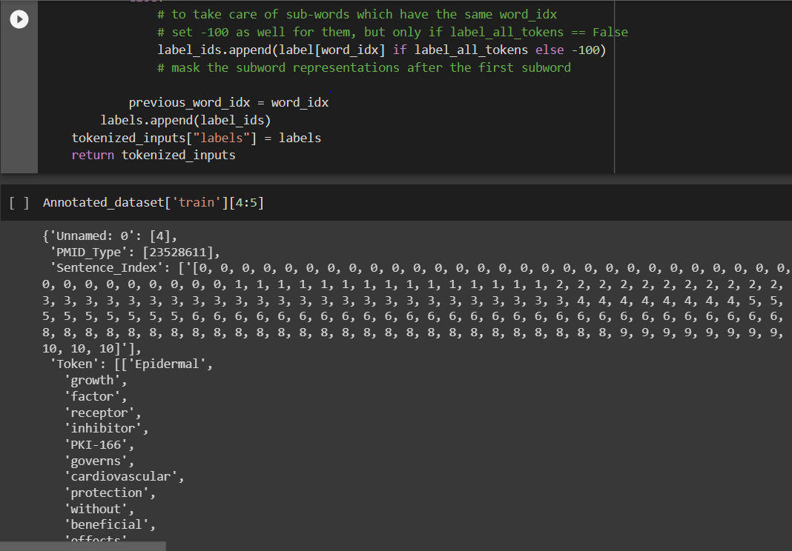
Let's define a function called tokenize_and_align_labels which will tokenize input text and align the corresponding labels while handling special and subword tokens. It will iterate iterates through the input examples, tokenizing the text and creating a list of word IDs. Then, it will align the labels by iterating through the word IDs, handling special tokens, first tokens of words, and subword tokens separately. The function returns a dictionary containing the tokenized inputs and the aligned labels, ensuring that the input tokens and labels are correctly aligned for training and evaluation.

Slide 26
Step 3: Let's Start with Training the Model

Slide 27
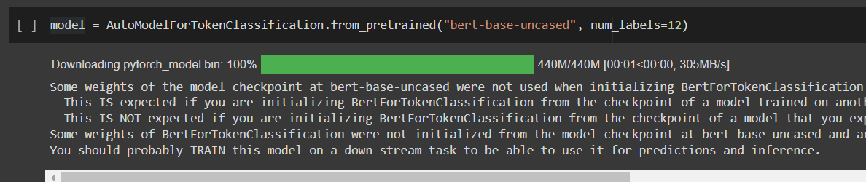
We have used a pre-trained BERT model for token classification tasks. It loads the BERT base model with uncased tokens and configures it with 12 labels (corresponding to the number of unique tags in the dataset). This allows us to fine-tune the model on our specific Named Entity Recognition (NER) task, as it initializes the model with pre-trained weights.

Slide 28

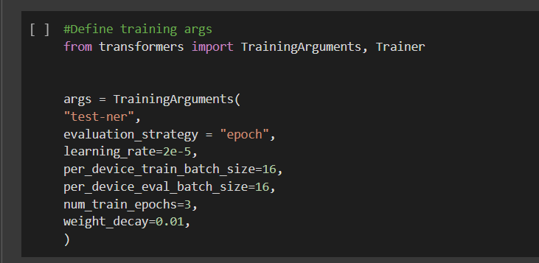
Defining the training arguments

Slide 29
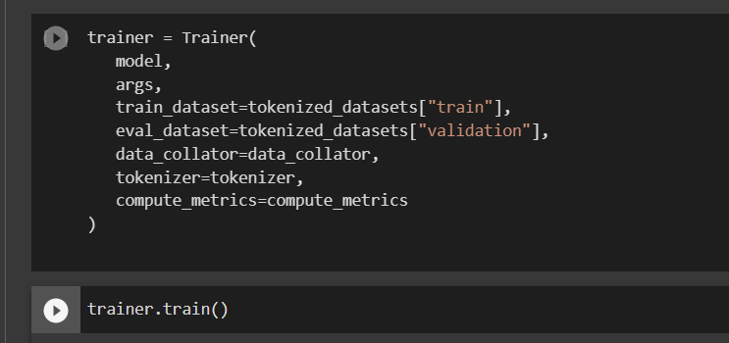
We will now initialize the Trainer class with the necessary parameters, including the model, training arguments, datasets, data collator, tokenizer, and the custom compute_metrics function. Then, we will train the model using trainer.train().

Slide 30
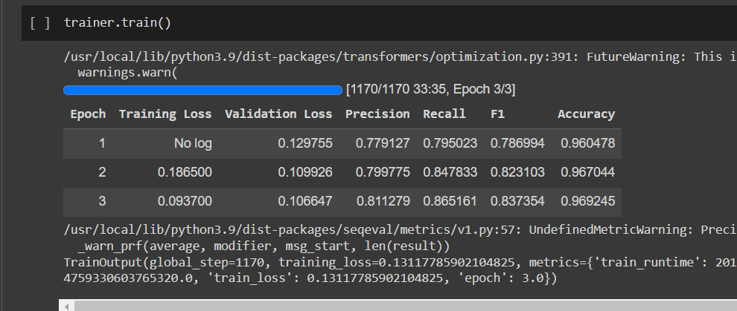
Step 4: Evaluation and Prediction on random data

Slide 31
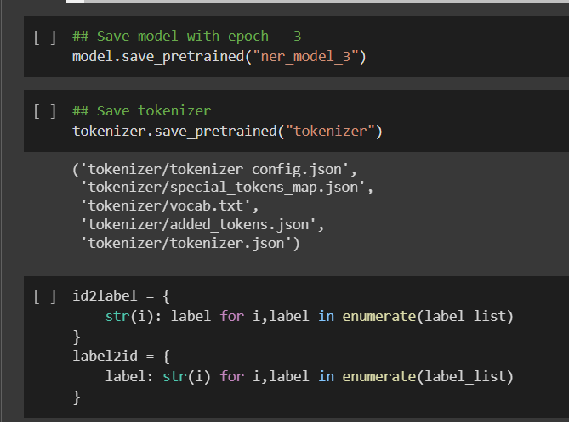

Slide 32
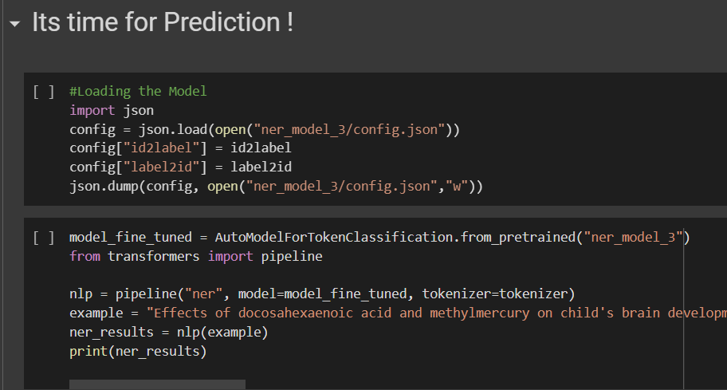

Slide 33
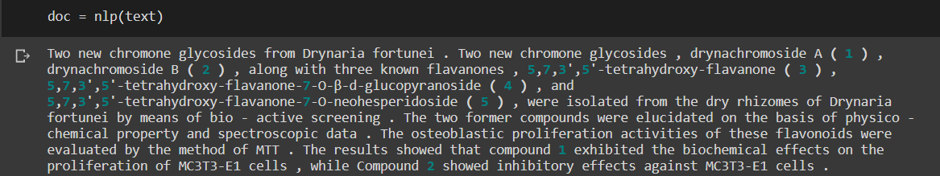
We have selected random instance from our validation set to test our model.

Slide 34
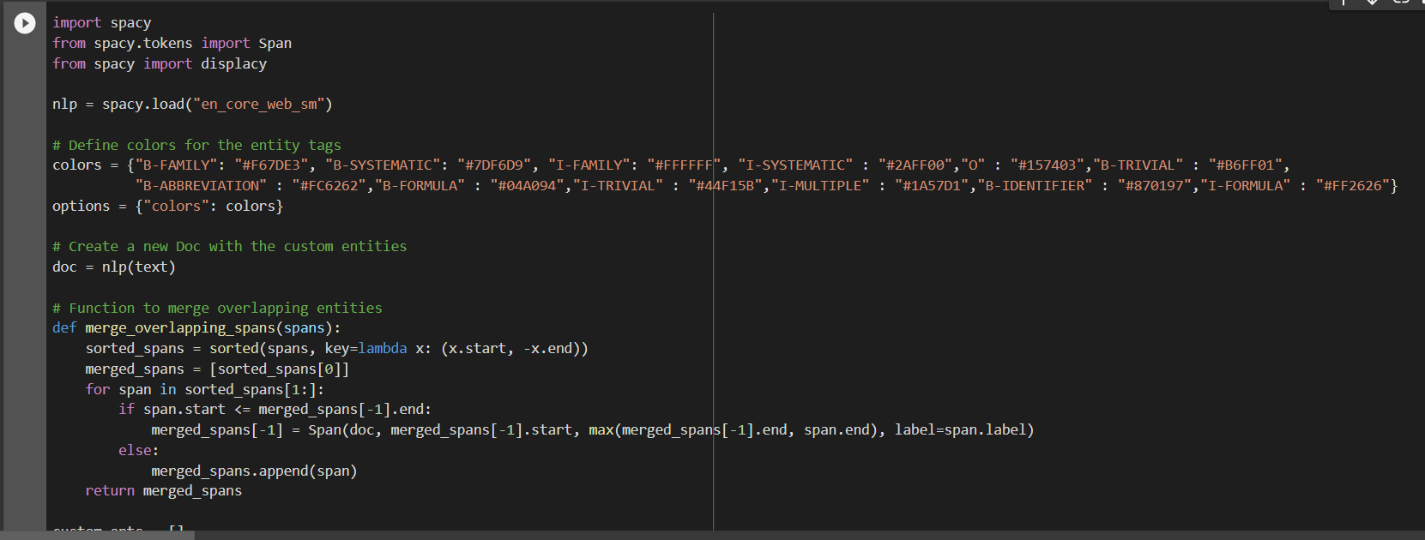
The purpose of the below code is to visualize custom entity recognition results in a given text that we generated in the last slide using the Spacy library. By assigning custom colors to different entity tags and merging overlapping entity spans, the code allows users to effectively inspect and analyze the performance of their custom Named Entity Recognition model. The resulting visualization displays the text with highlighted entities, making it easier to identify potential improvements or adjustments needed for the model.

Slide 35
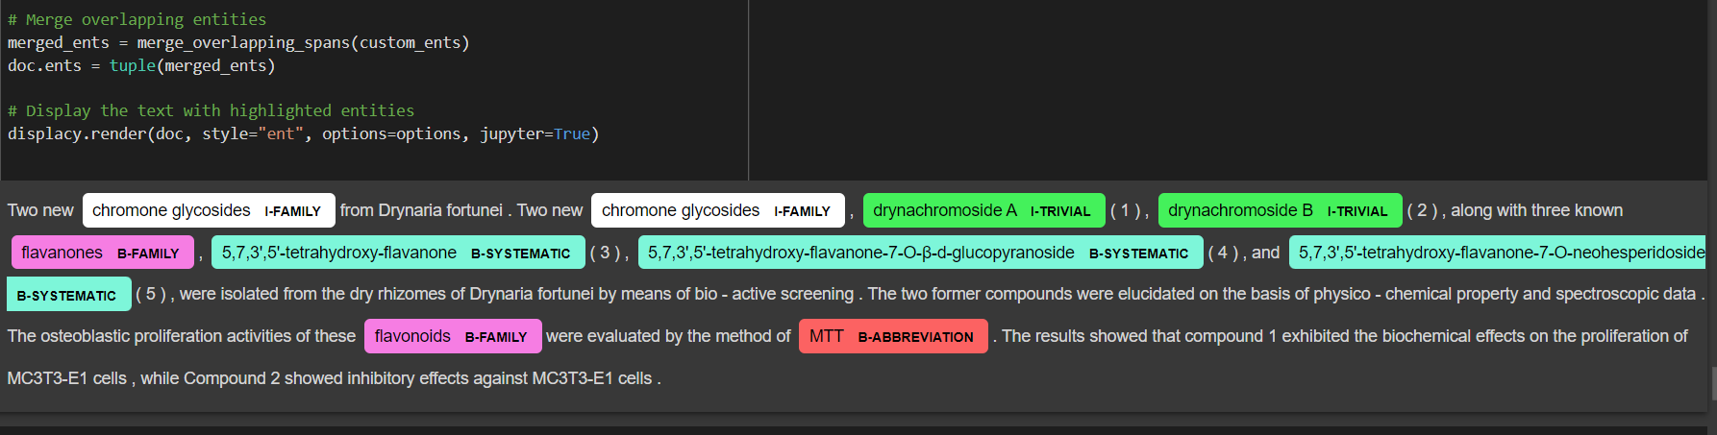
Result 1: Displaying the text with highlighted entities, making it easier to identify potential improvements or adjustments needed for the model.

Slide 36
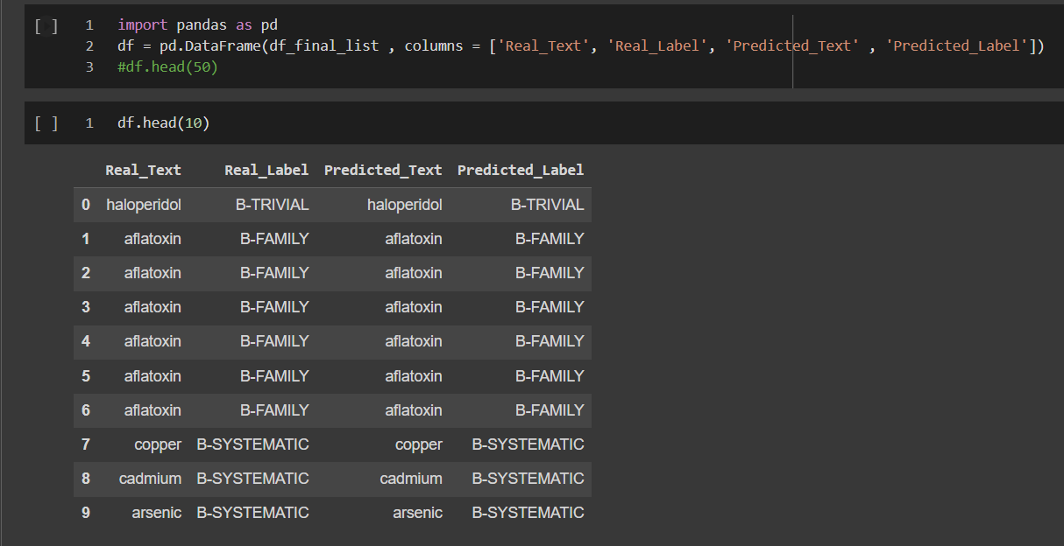
Result 2: Real Label vs Predicted Label

Slide 37
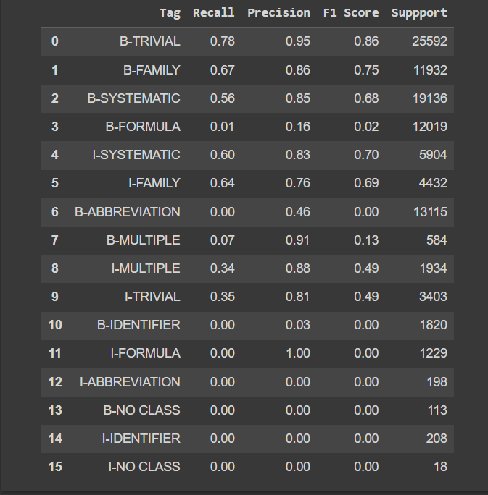
Result 3: Overall Performance

Slide 38

Applications of Our Project

Slide 39
The project we worked on focuses on chemical Named Entity Recognition (NER) using the ChemdNER dataset, which is designed to recognize chemical compound names and their variations in text. This has several important applications and uses in various domains:
Drug discovery and development: Identifying chemical entities can help researchers find new drug candidates, understand drug interactions, and track the progress of compounds in clinical trials.
Chemical patent analysis: By recognizing chemical compounds in patent documents, researchers can study trends in chemical innovations, assess the novelty of new inventions, and identify potential licensing opportunities.
Scientific literature mining: Extracting chemical entities from scientific articles enables the automated extraction of knowledge, which can be useful for literature reviews, meta-analyses, and hypothesis generation.
Chemical database curation: Automatic recognition of chemical names can help to maintain and update chemical databases, ensuring they are accurate and up-to-date, thus aiding researchers in their work.
Environmental and safety monitoring: Identifying chemical compounds in various reports or documents allows for better monitoring of hazardous substances, assessing environmental risks, and ensuring compliance with safety regulations.
Educational purposes: Instructors and students can use the NER system to analyze and understand chemical texts more efficiently, which can aid in learning and teaching chemistry.
By improving the ability to automatically identify and classify chemical entities in text, this project can contribute to advancements in these areas, ultimately benefiting various stakeholders such as researchers, regulators, and educators.

Slide 40

Future Scope

Slide 41
The future scope of this project can include:
Integrating OCR (Optical Character Recognition) to extract text from images or scanned documents, allowing the model to identify chemical entities from a wider range of sources.
Additionally, the project could be extended to support multiple languages or to recognize more complex entity types, such as chemical reactions or structures. Integration with other machine learning models, such as those for predicting chemical properties or simulating chemical reactions, could further enhance the project's potential to assist researchers in their work.
Finally, developing a user-friendly interface for non-technical users, such as chemists and pharmacologists, could make the project more accessible and impactful across various domains.

Slide 42
References
Krallinger, M. et al. The CHEMDNER corpus of chemicals and drugs and its annotation principles. J Cheminform, 2014
ChatGPT for debugging and organizing
Stackoverflow

Slide 43
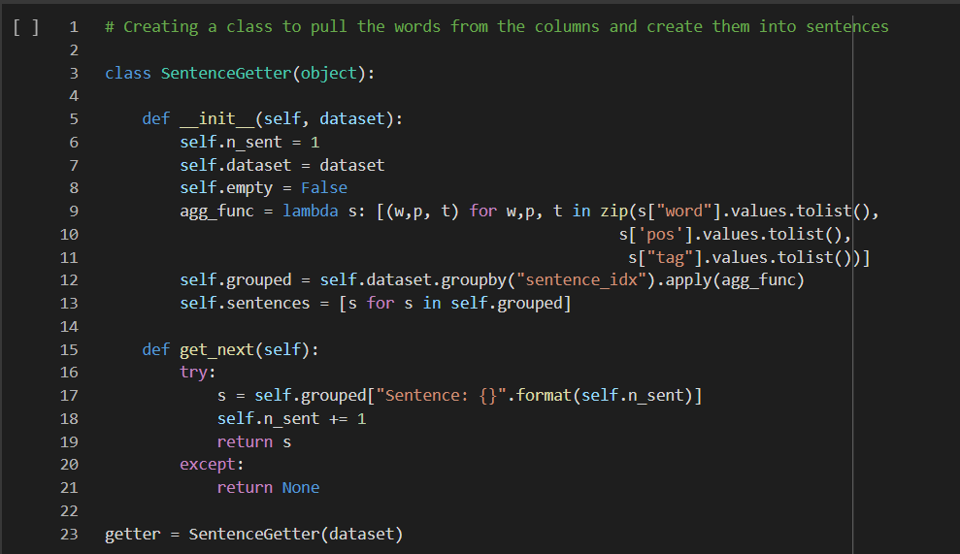
APPENDIX

Slide 44
